Slide 1

Video #13
BEGINNER TO EXPERT GUARANTEED
NETWORKING - 2
ULTIMATE IT COURSE
ACCESS COURSE PLAYLIST LINK IN DESCRIPTION
SUBSCRIBE!!!

Slide 2
Answers
Abbrevation of CAN ? (Campus Area Network)
Cisco Basic Certification for Networking ? (CCNA/CCNP/CCIE)
Connected Bluetooth Neckband is an example of ? (PAN/CAN/LAN/WAN)
Identify Delhi, Chennai, Kanpur & Sydney Network ? (MAN/LAN/WAN/WLAN)
Which Technology is used by WLAN & WPAN ?
WLAN :- Uses Wifi for Connectivity under local area network
WPAN :- Uses Bluetooth for Connectivity under Personal area network
Solve all question and comment down answers...

Slide 3
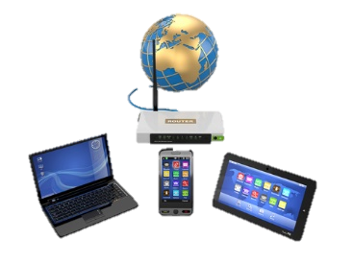

Slide 5

TYPES OF INTERNETWORKING

Slide 6
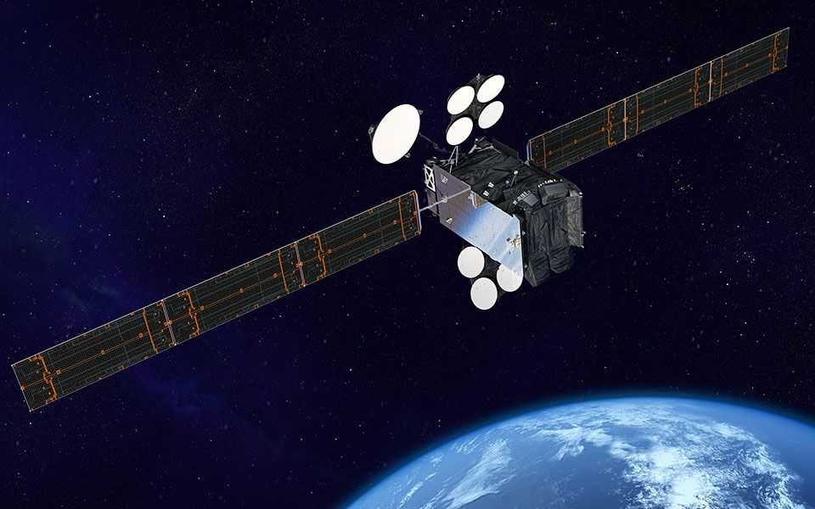

Slide 7
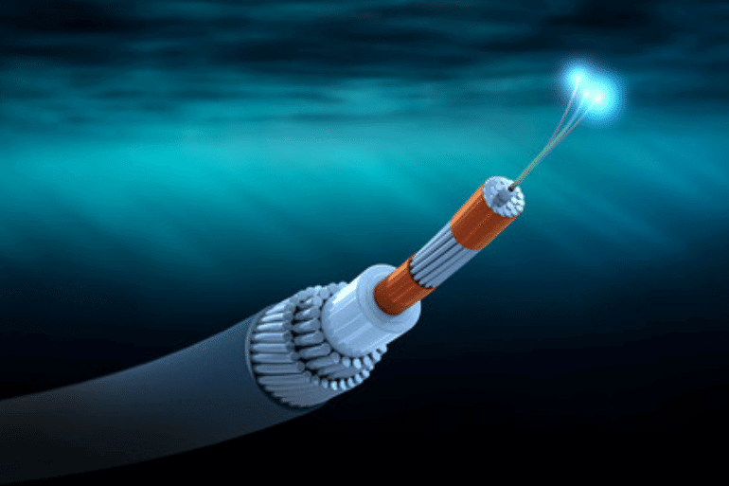

Slide 8
Questions:-
Submarine Cables are type of ? (DSL/Coaxial/Optic Fibre/STP/UTP)
Name two types of Internetworking?
If internet is free then why we pay to ISPs?
Which Continent is not connected with submarine cables?
Name 5 ISPs who provide internet?
Solve all question and comment down answers...

